Slide 1
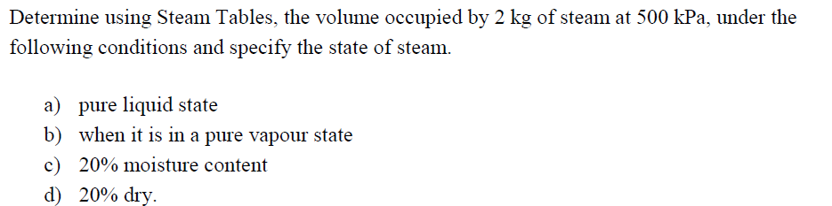
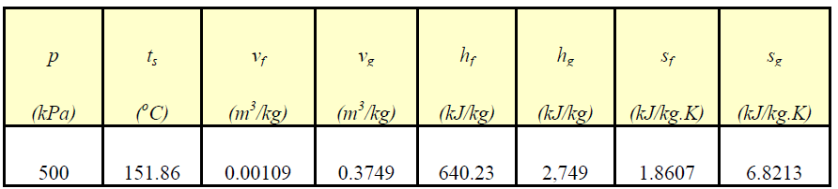

Slide 2
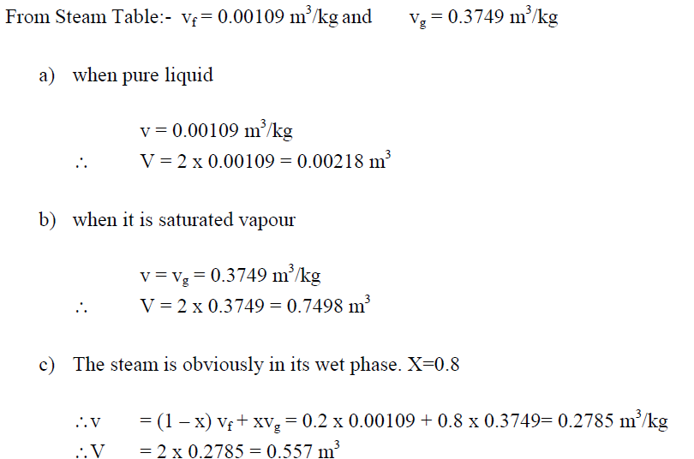

Slide 3
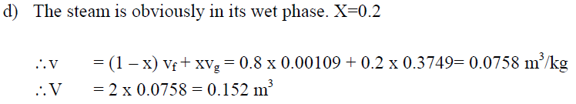

Slide 4

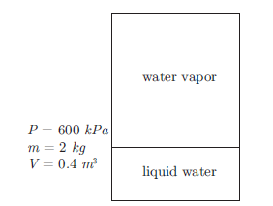

Slide 5
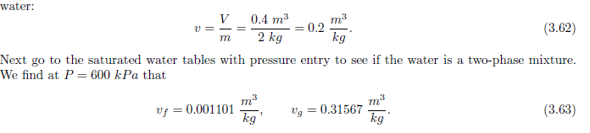
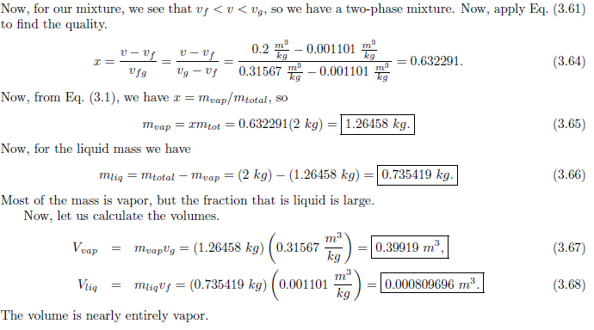

Slide 6
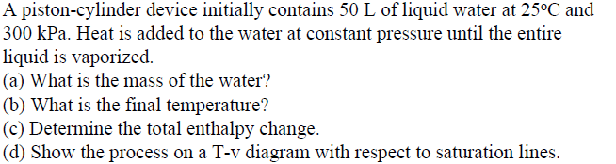

Slide 7
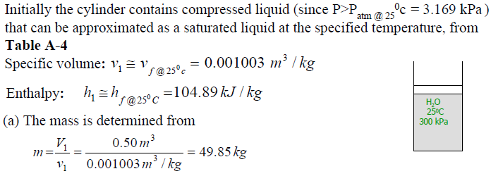
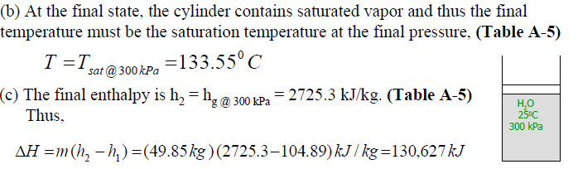

Slide 8
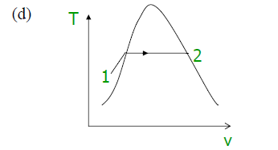

Slide 9
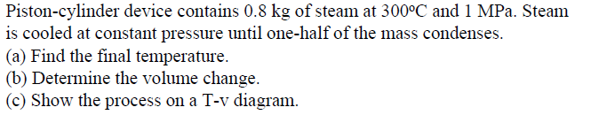

Slide 10
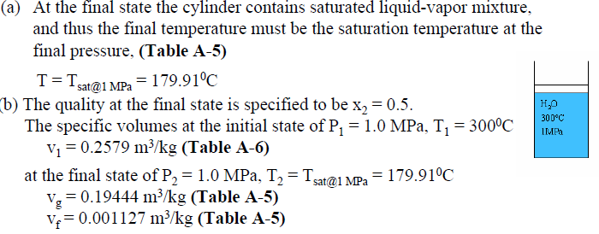
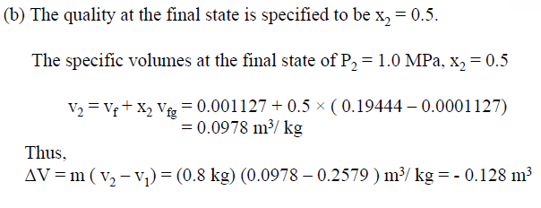

Slide 11
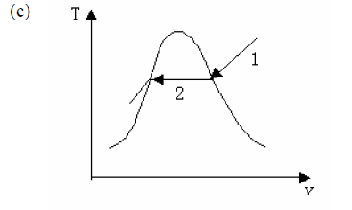

Slide 12
Example: Superheated water vapor is entering the steam turbine with a mass
flow rate of 1 kg/s and exhausting as saturated steamas shown. Heat loss from
the turbine is 10 kW under the following operating condition. Determine the
power output of the turbine.
P=1.4 Mpa
T=350° C
V=80 m/s
z=10 m
10 kw
P=0.5 Mpa
100% saturated steam
V=50 m/s
z=5 m

Slide 13
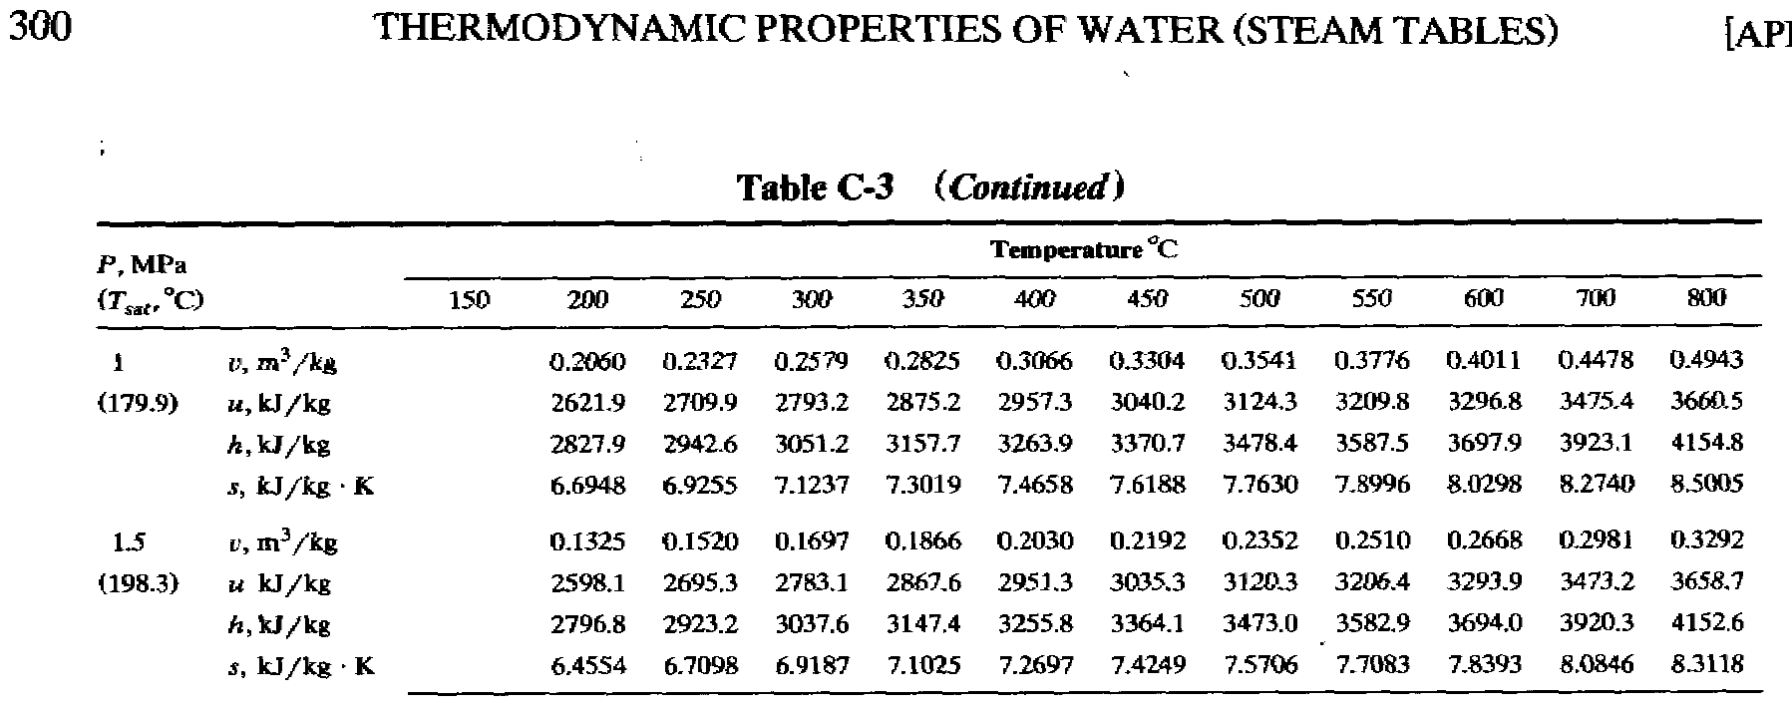
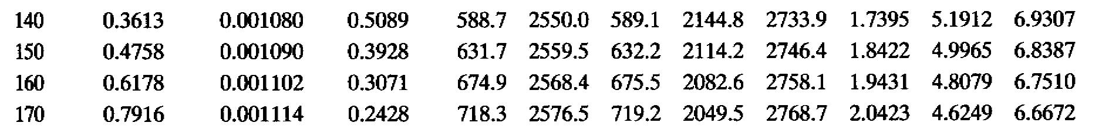

Slide 14
Saturated Steam Table
h_{fg} (kJ/kg)
p (Mpa)
h_{g} (kJ/Kg)
h_{f} (kJ/kg)
h_{g}(p=0.5 Mpa) = 2746.4 + (2758.1-2746.4)/(0.6178-0.4758)*(0.5-0.4758)
=2748.4 kJ/kg for 100% quality saturated vapor

Slide 15
Superheated Steam
h(p=1MPa, T=350°C)=3157.7 kJ/kg
h(p=1.5MPa, T=350°C)=3147.4 kJ/kg
h(p=1.4MPa, T=350°C)=3157.7+(3147.7-3157.7)*(0.4/0.5)
=3149.7 (kJ/kg)

Slide 16
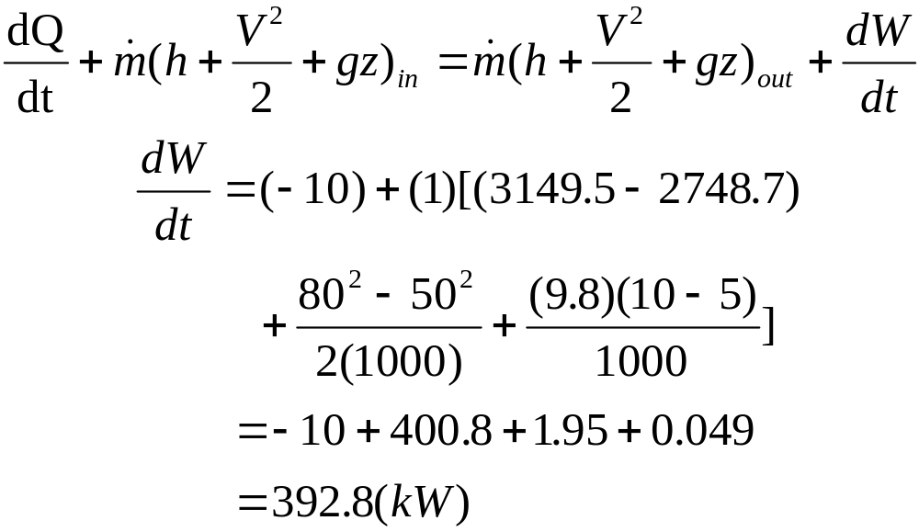
Example: Superheated water vapor is entering the steam turbine with a mass
flow rate of 1 kg/s and exhausting as saturated steamas shown. Heat loss from
the turbine is 10 kW under the following operating condition. Determine the
power output of the turbine.
P=1.4 Mpa
T=350° C
V=80 m/s
z=10 m
From superheated vapor table:
h_{in}=3149.5 kJ/kg
10 kw
P=0.5 Mpa
100% saturated steam
V=50 m/s
z=5 m
From saturated steam table: h_{out}=2748.7 kJ/kg

